Slide 1
Fastag Fraud detection
-Tejashree.R

Slide 2
Contents
Data Exploration
Feature Engineering
Model Development
Exploratory analysis

Slide 3
Data Exploration
Features in the dataset
1. Transaction_ID: Unique identifier for each transaction.
2. Timestamp: Date and time of the transaction.
3. Vehicle_Type: Type of vehicle involved in the transaction.
4. FastagID: Unique identifier for Fastag.
5. TollBoothID: Identifier for the toll booth.
6. Lane_Type: Type of lane used for the transaction.
7. Vehicle_Dimensions: Dimensions of the vehicle.
8. Transaction_Amount: Amount associated with the transaction.
9. Amount_paid: Amount paid for the transaction.
10. Geographical_Location: Location details of the transaction.
11. Vehicle_Speed: Speed of the vehicle during the transaction.
12. Vehicle_Plate_Number: License plate number of the vehicle.
13. Fraud_indicator: Binary indicator of fraudulent activity (target variable).

Slide 4
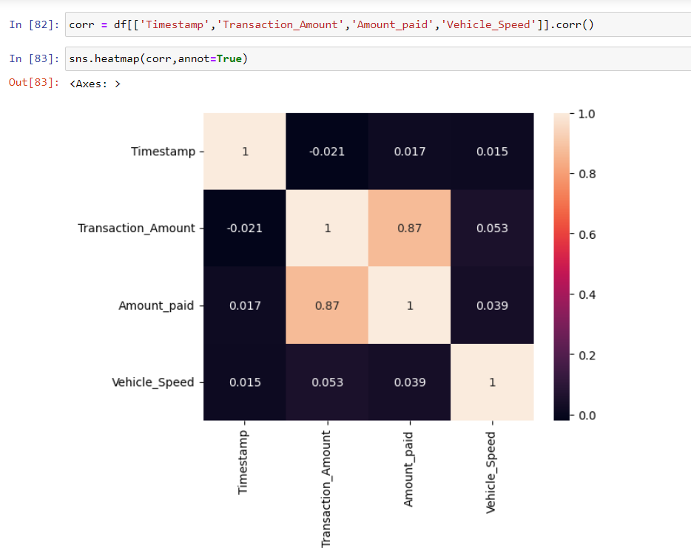
Not all features in the dataset are important. So we drop the unnecessary columns that don’t contribute to the classification. Here we drop the Transaction_ID , FastagID and Vehicle_Plate_Number columns
We plot the first have to understand the distribution of various values in the dataset.
So we have to plot the correlation between the numerical columns.

Slide 5
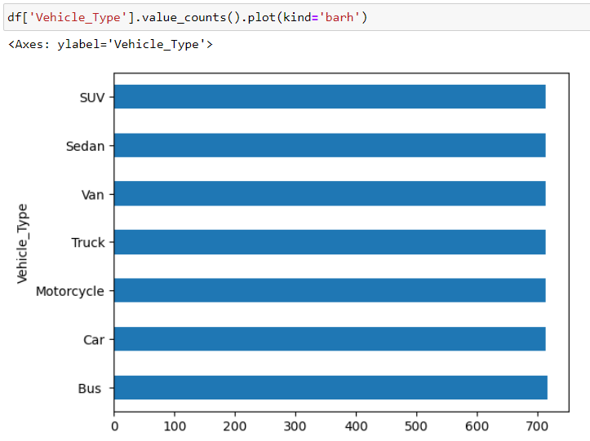
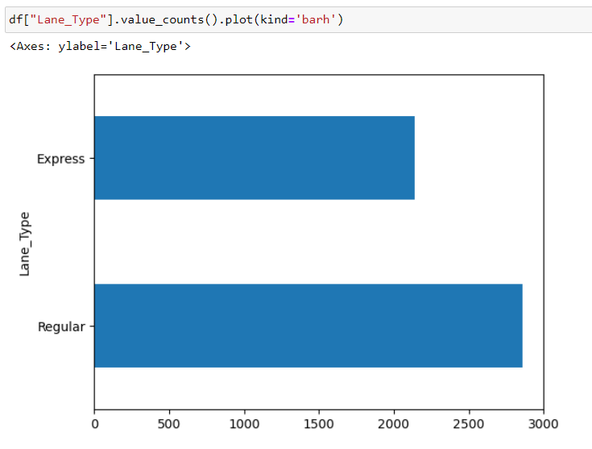
For the categorical columns we have to identify the number of records belonging to the each class of the column.
This helps us identify if the dataset is biased.

Slide 6
Here we could identify that the number of records belonging to fraud is very less compared to not fraud. But later during feature engineering we have performed binning operation for the timestamp column that has compensated for this bias in the data. The model performs exceptionally well even without the data augmentation.

Slide 7
Feature Engineering
Numerical columns – Transaction_Amount , Amount_paid , Vehicle_Speed
For numerical columns – Standardization is performed
Categorical columns – Vehicle_Type , TollBoothID , Lane_Type , Vehicle_Dimensions , Geographical_Locations , Fraud_indicator.
For Categorical columns we perform label encoding

Slide 8
The Timestamp column was of the datatype object. So we convert it to datetime and perform binning operation.
Here we have bins for values based on the hours.
0 – 00:00 to 3:59
1 – 4:00 to 7:59
2 – 8:00 to 11:59
3 – 12:00 to 15:59
4 – 16:00 to 19:59
5 – 20:00 to 23:59
And now we perform LabelEncoding

Slide 9
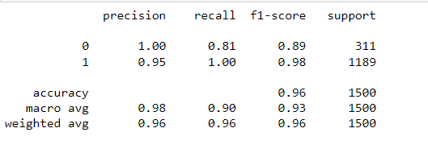
Model development
Logistic Regeression:
linear classification with probability output

Slide 10
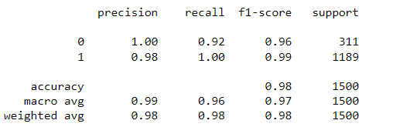
Support Vector Machine:
powerful for non-linear data but less interpretable

Slide 11
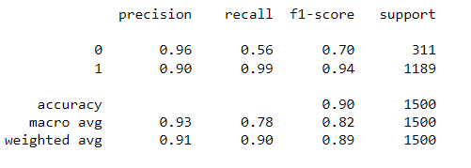
K Nearest Neighbour
simple and adaptable but computationally expensive for large datasets.

Slide 12
THANK YOU

